Slide 1


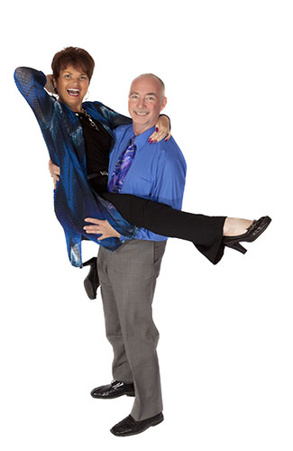
Welcome Home!
Unity Center for Y[Universal Prosperity
Revs. Drs. Bil & Cher Holton
© Bil & Cher Holton, permission to ucfyp.org

Slide 2
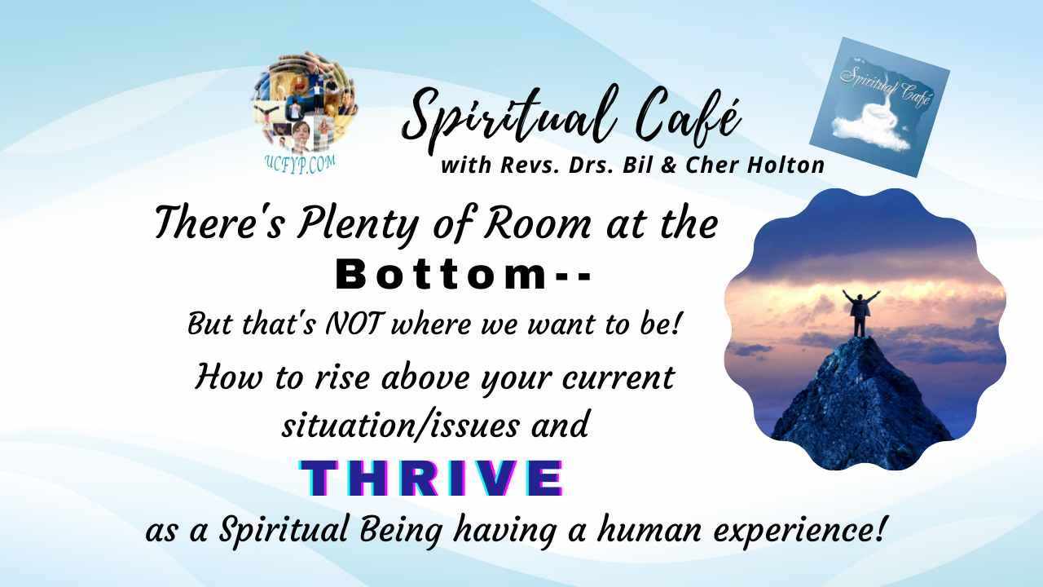
© Bil & Cher Holton, permission to ucfyp.org

Slide 3

The Climb, by Miley Cyrus -- With permission:
https://youtu.be/T_ivwsIWYOw`

Slide 4




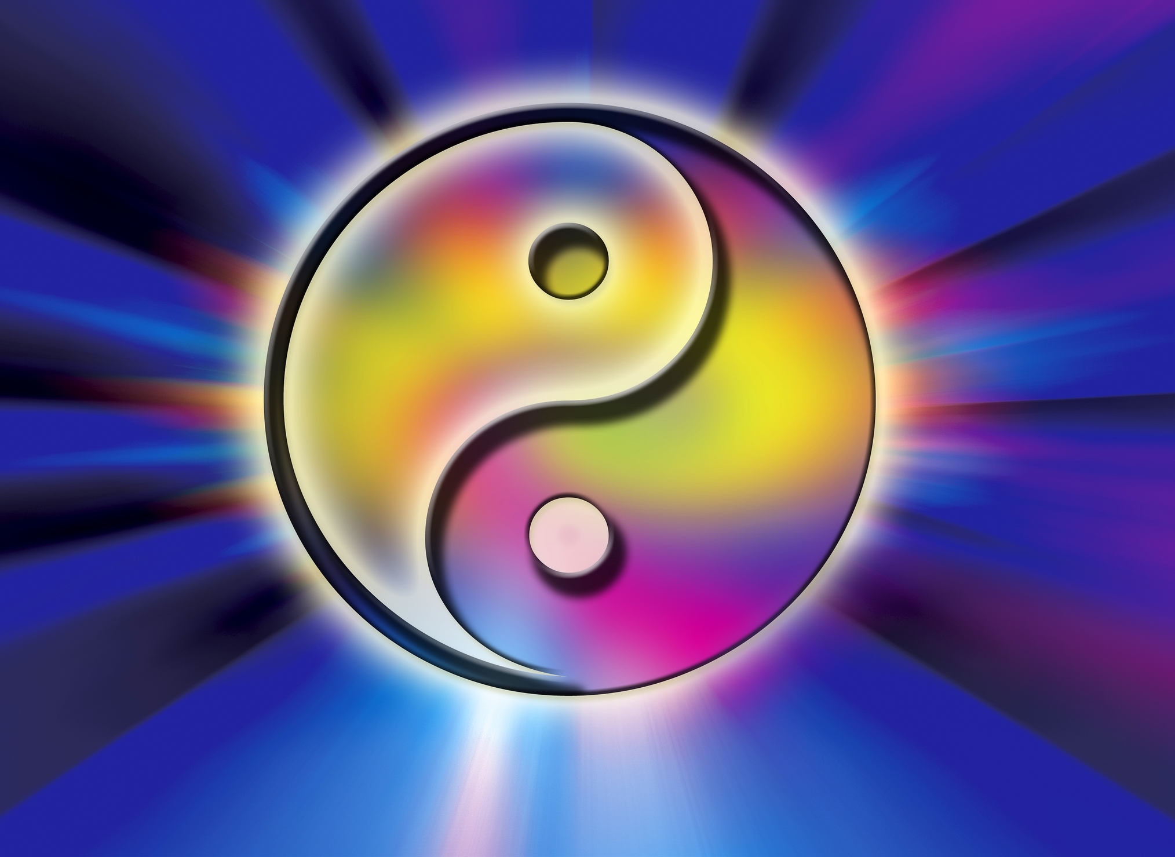
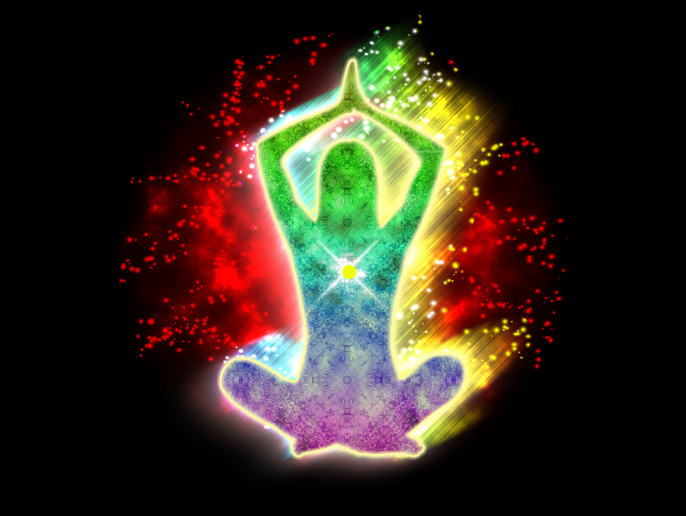

Our Spiritual Practices, Principles, and Beliefs are Incredible tools
that help us master the art of living in skin school!
© Bil & Cher Holton, permission to ucfyp.org

Slide 5
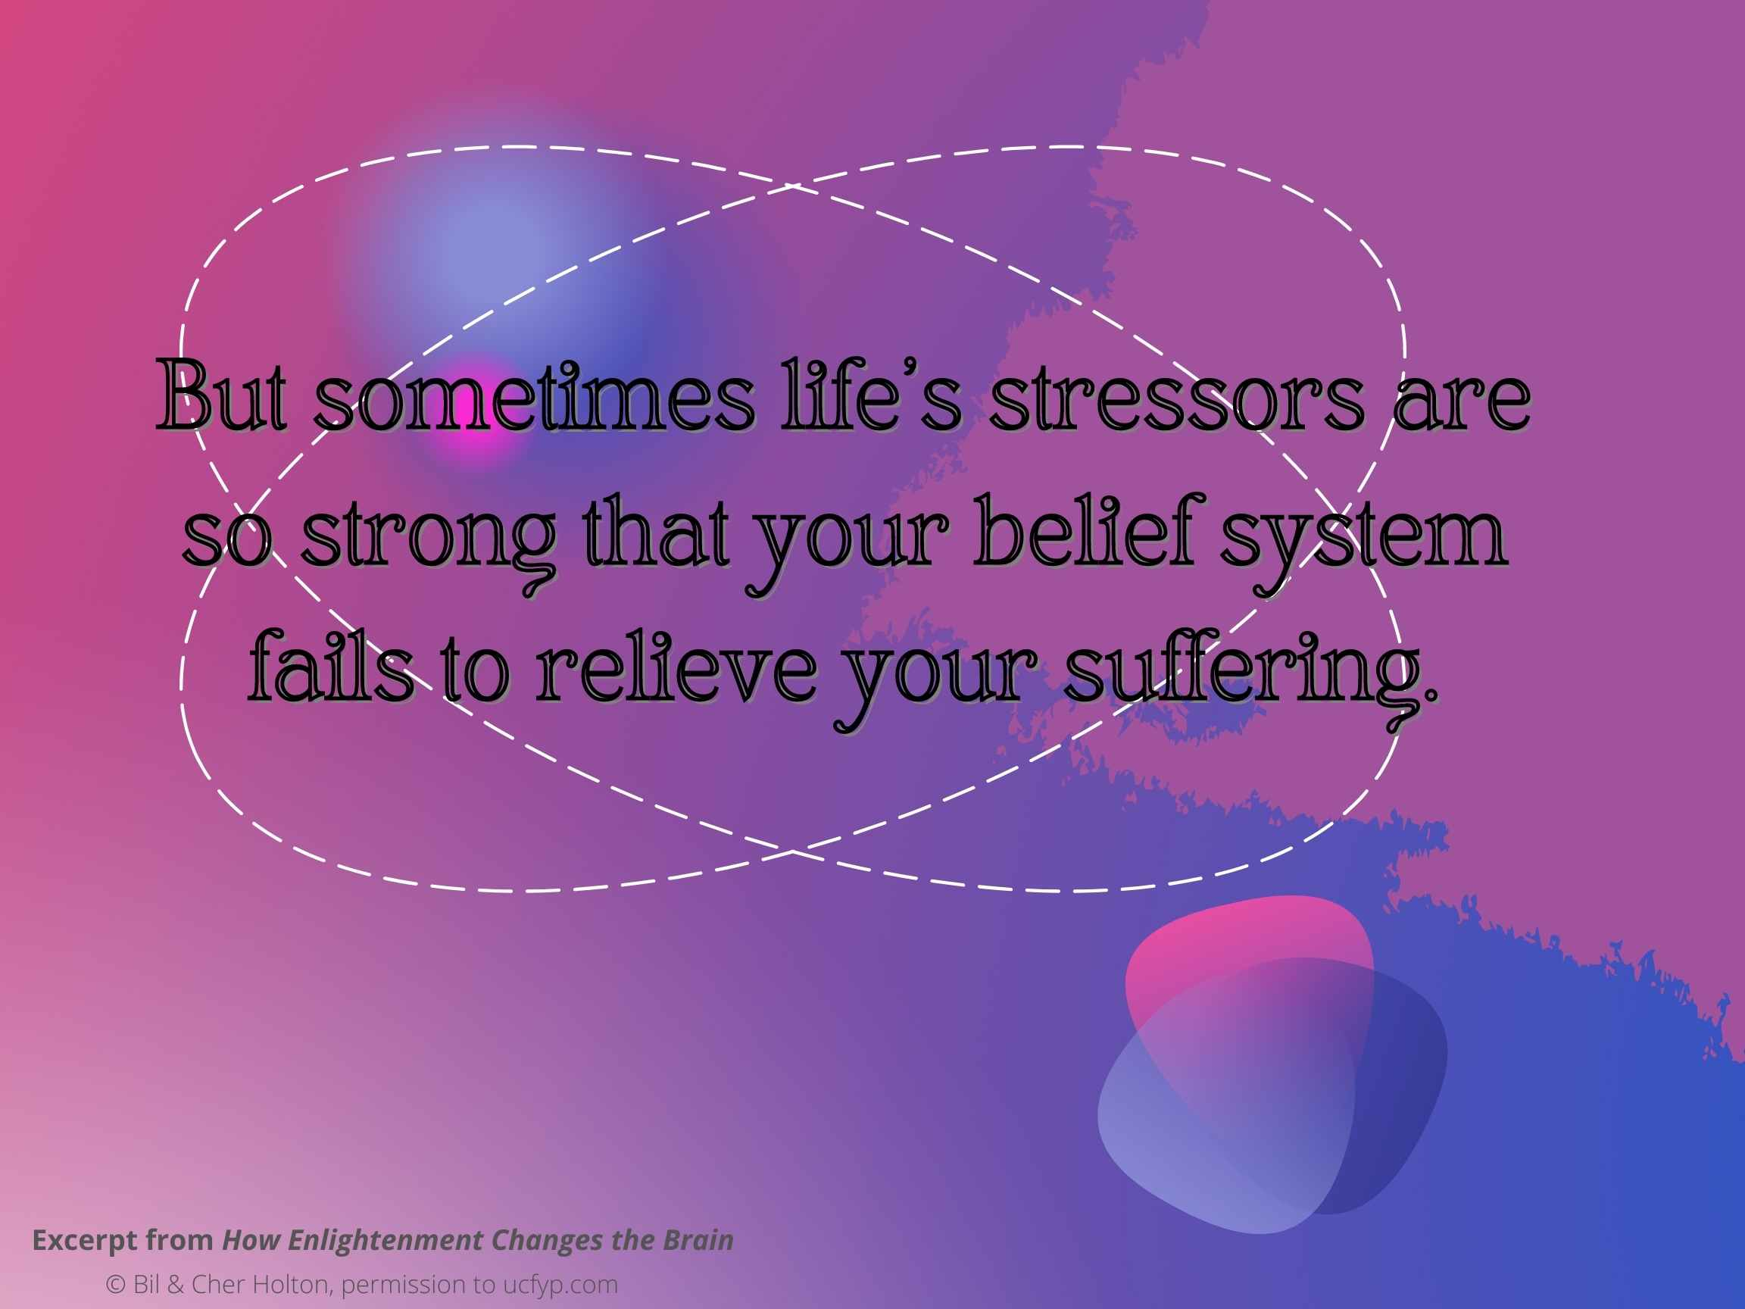
In that deep despair, you may realize it is time to try something
new.
Excerpt from How Enlightenment Changes the Brain,
Andrew Newberg & Mark Waldman
© Bil & Cher Holton, permission to ucfyp.org

Slide 6
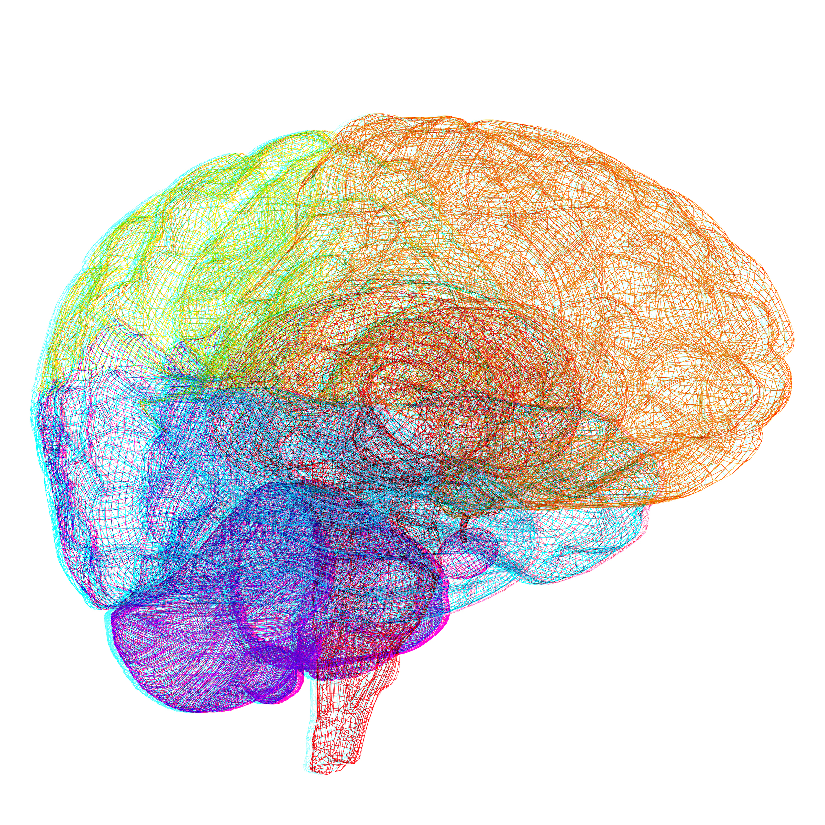
Any change in our environment,
or in our brain
Stimulates the amygdala
causing us to react with
Uncertainty
FEAR!
or
Excerpt from How Enlightenment Changes the Brain,
Andrew Newberg & Mark Waldman
© Bil & Cher Holton, permission to ucfyp.org

Slide 7
One Basic Neurological Rule:
You must suspend, at least for a moment, every habituated belief you have previously held about yourself and the world.
You have to interrupt the memories that constantly flood your everyday consciousness, controlled by your frontal lobe, and allow your existing belief system to transform.
You’ll experience the present moment with greater intensity as powerful neuro-chemicals are released throughout your brain.
© Bil & Cher Holton, permission to ucfyp.org
Excerpt from How Enlightenment Changes the Brain,
Andrew Newberg & Mark Waldman

Slide 8

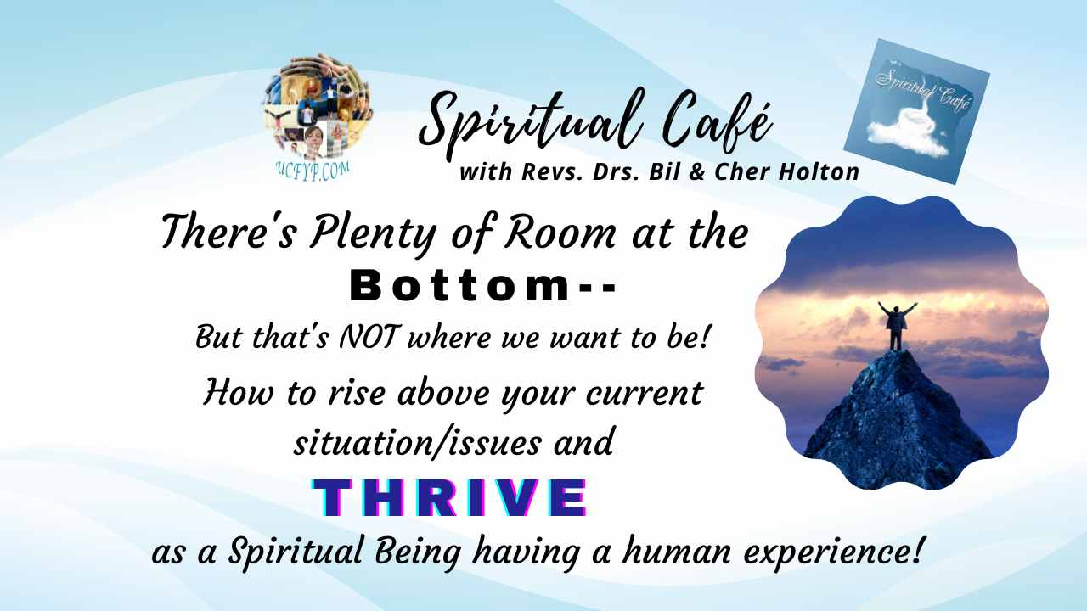

Your thoughts will change!
Your feelings will change!
New memories will be formed!
It’s not always easy, but your life, as you once knew it, will never be the same!
© Bil & Cher Holton, permission to ucfyp.org
Excerpt from How Enlightenment Changes the Brain,
Andrew Newberg & Mark Waldman

Slide 9

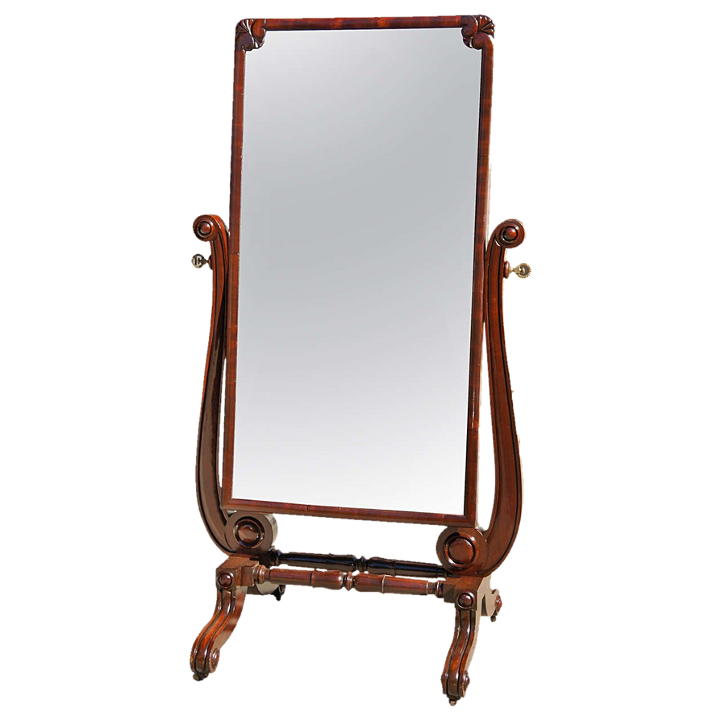
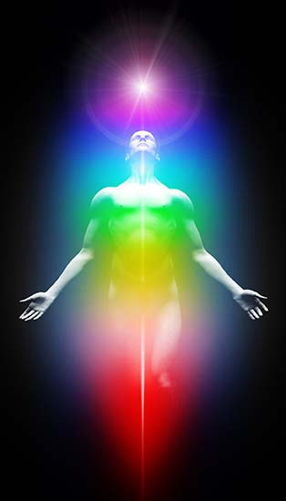


Spiritual Practice
Cosmic Mirror
Using both your spiritual and psychological maturity in your current skin school experience, simply start by looking in a mirror and probe how well you’ve brought the poise of your Divine Nature to the noise of your current life circumstances.
Then eliminate negative thoughts, choices and actions (negative karmic influences) and reinforce positive thoughts, choices, and actions (positive karmic influences)!
When you do that, having looked at yourself in the proverbial mirror turns out to be a Cosmic Mirror that helps you set your course of actions straight. Lightening, and hopefully eliminating, your negative karmic load will help you make your present life much more happy, healthy, wealthy, and wise!
© Bil & Cher Holton, permission to ucfyp.org

