Slide 1


Enlighten Up!
© Bil & Cher Holton, permission to ucfyp.org

Slide 2

So what are your favorite higher consciousness pursuits?
© Bil & Cher Holton, permission to ucfyp.org

Slide 3

© Bil & Cher Holton, permission to ucfyp.org

Slide 4

Could it be a
“Both/And?”
© Bil & Cher Holton, permission to ucfyp.org

Slide 5
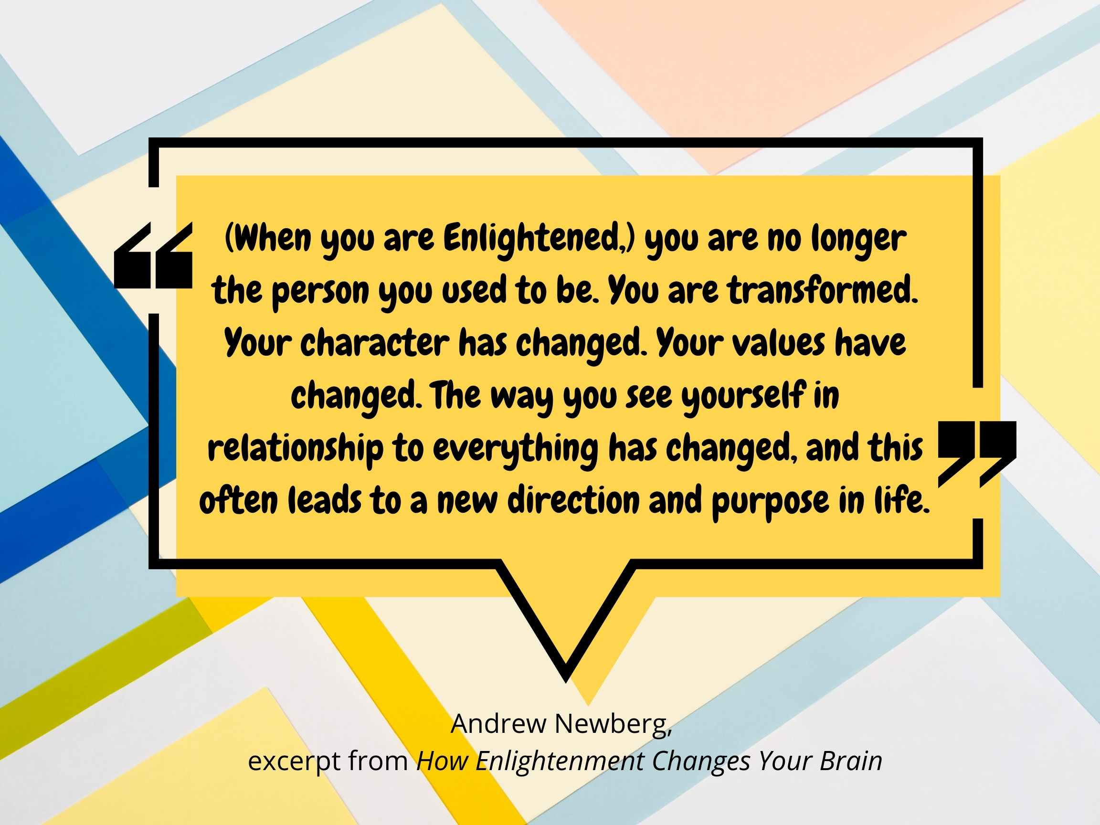
© Bil & Cher Holton, permission to ucfyp.org

Slide 6

So what is
Meditation?
© Bil & Cher Holton, permission to ucfyp.org

Slide 7
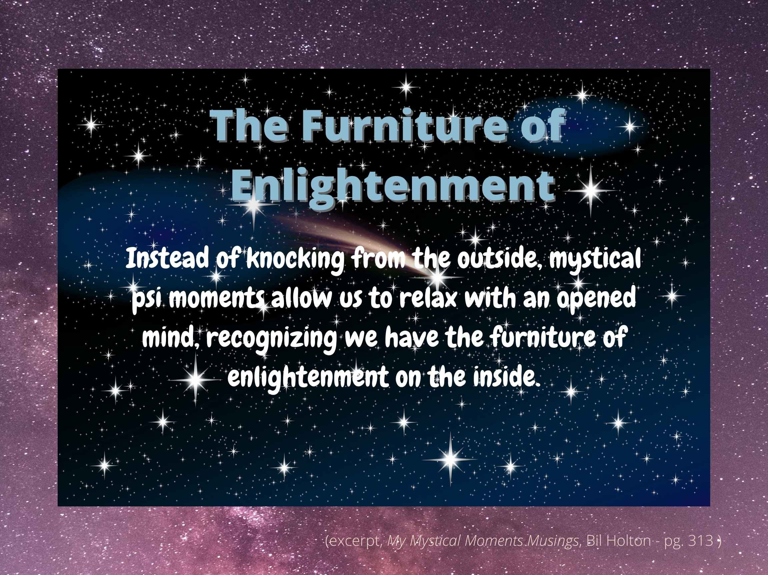
© Bil & Cher Holton, permission to ucfyp.org

Slide 8
How would you define the
Furniture of Enlightenment?
© Bil & Cher Holton, permission to ucfyp.org

Slide 9
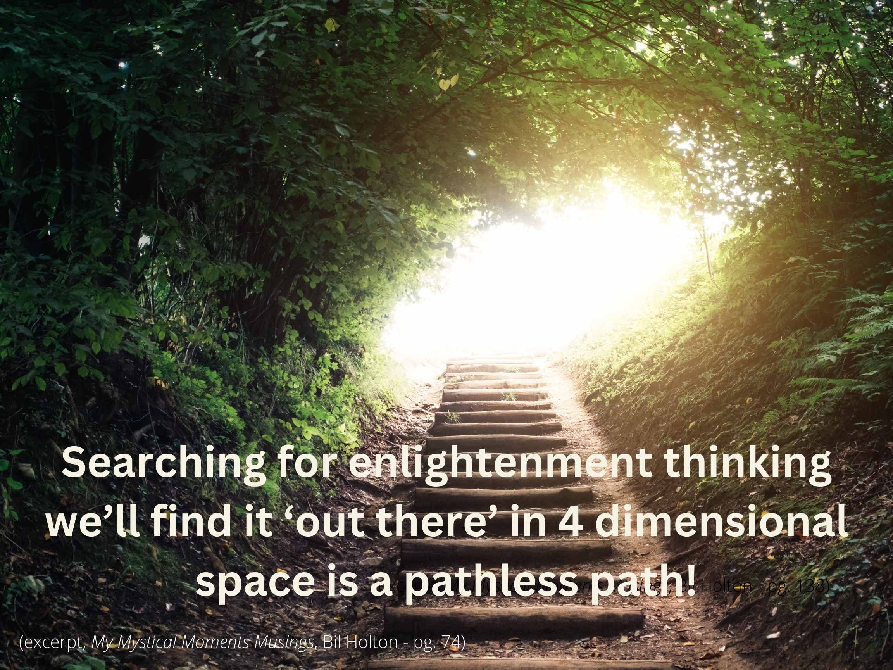
© Bil & Cher Holton, permission to ucfyp.org

Slide 10

© Bil & Cher Holton, permission to ucfyp.org

Slide 11
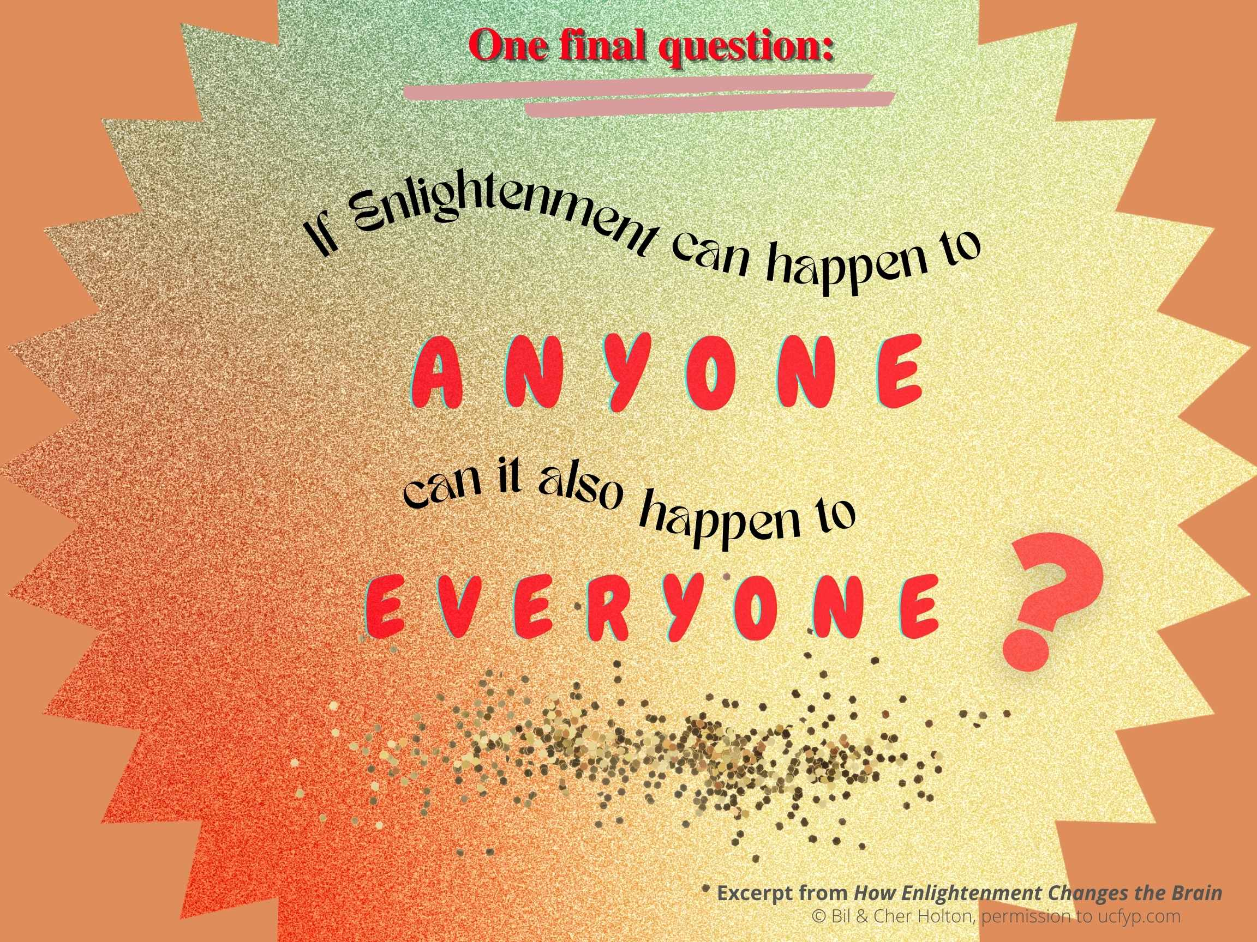
© Bil & Cher Holton, permission to ucfyp.org

Slide 12
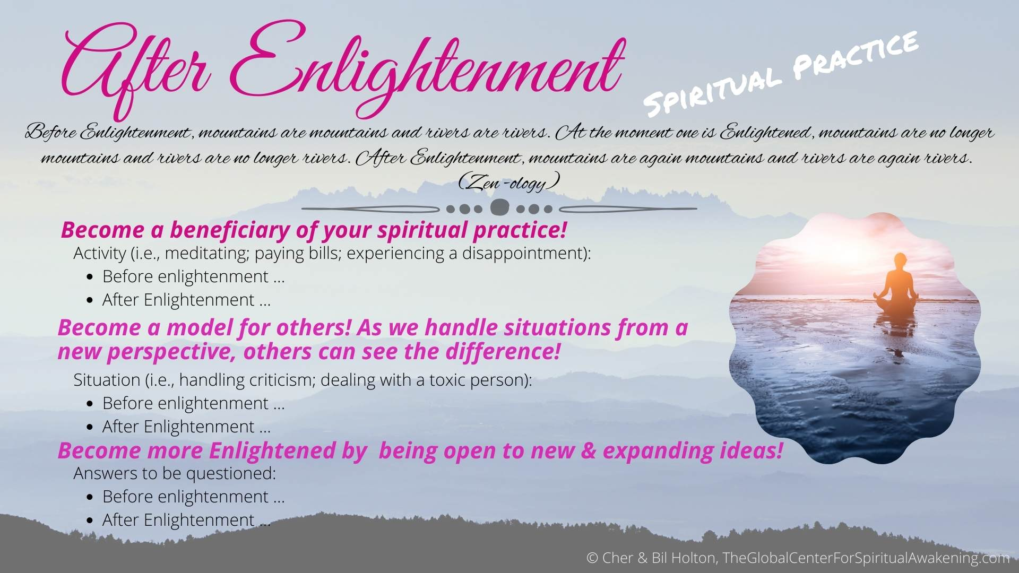
© Bil & Cher Holton, permission to ucfyp.org

