Slide 1


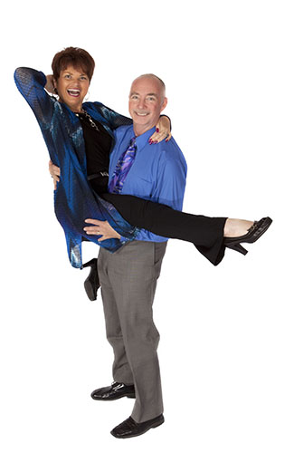
Welcome Home!
Unity Center for Y[Universal Prosperity
Revs. Drs. Bil & Cher Holton
© Bil & Cher Holton, permission to ucfyp.org

Slide 2
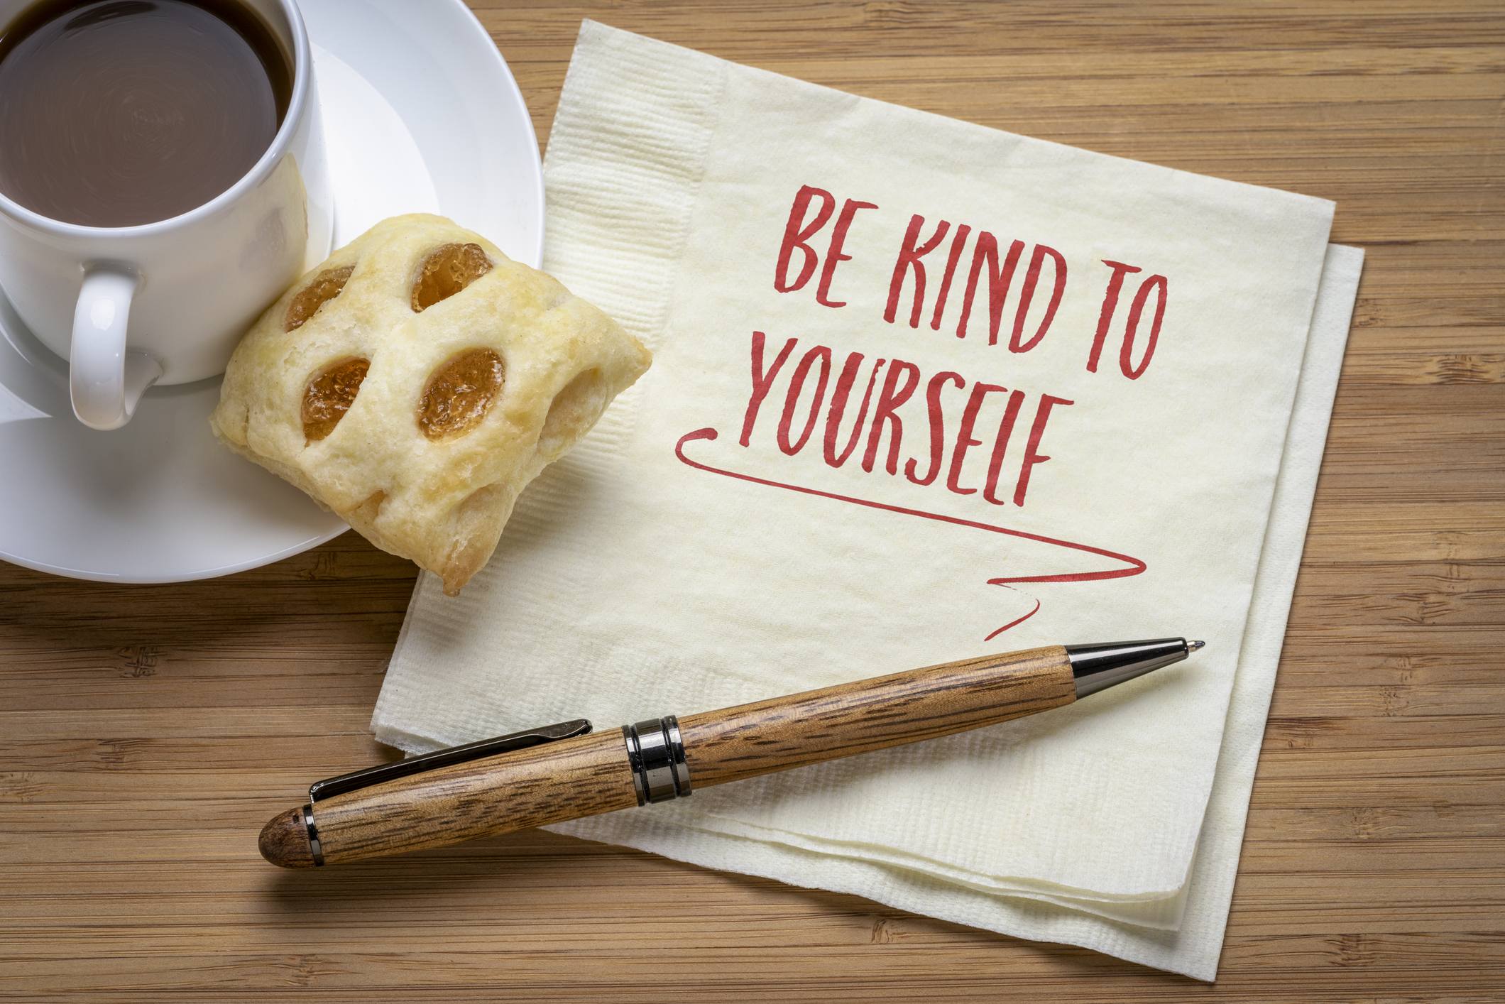
Reflection Question
What does “Being Kind to Yourself” mean to you?
© Bil & Cher Holton, permission to ucfyp.org
Image: dreamstime _234424212, with permission

Slide 3
Reflection Question
How do you allow unrealistic expectations and comparisons to affect your ability to be kind to yourself?
© Bil & Cher Holton, permission to ucfyp.org
Image: dreamstime _234424212, with permission

Slide 4
Reflection Question
How can you extend the same level of kindness to yourself that you extend to others?
© Bil & Cher Holton, permission to ucfyp.org
Image: dreamstime _234424212, with permission

Slide 5
Reflection Question
How can you make self-kindness a consistent and integral part of your life … especially during challenging times?
© Bil & Cher Holton, permission to ucfyp.org
Image: dreamstime _234424212, with permission

Slide 6
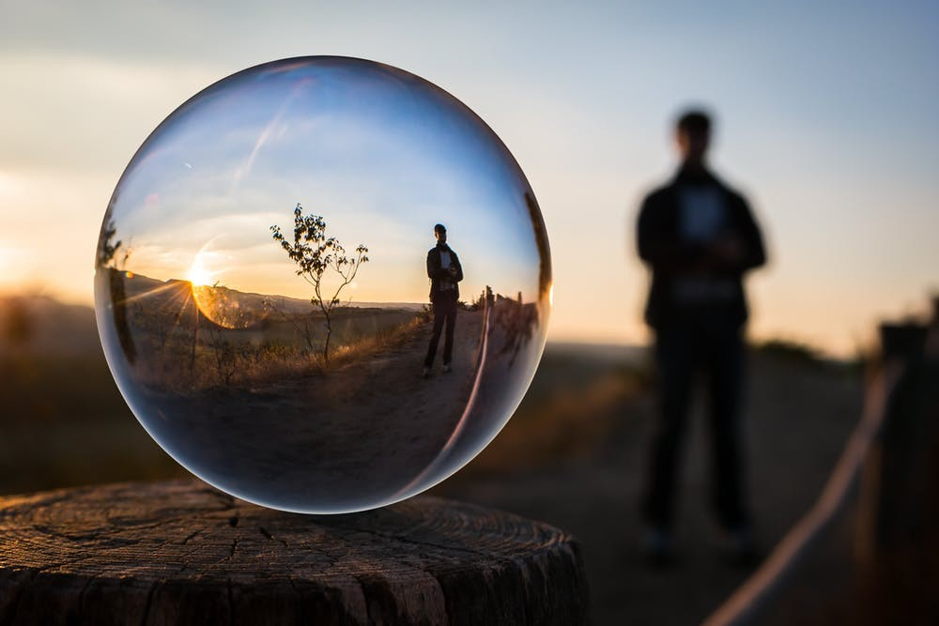
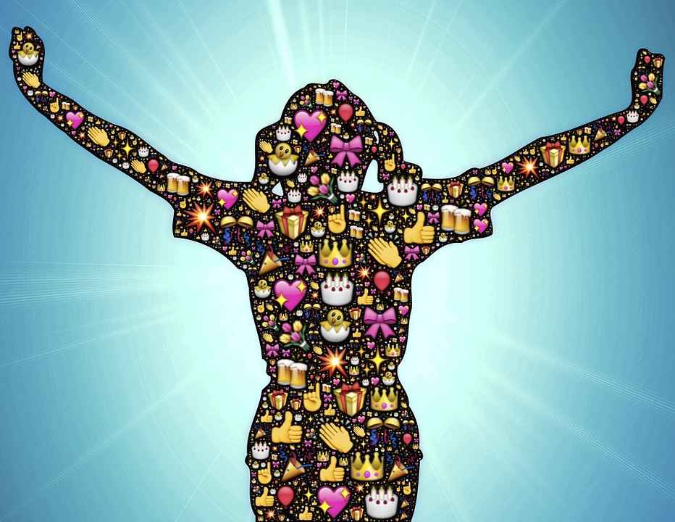

Here are 3 techniques to put into practice immediately to help you value the Extraordinary You by Being Kind to Yourself!
Spiritual Practice
Conduct a Self-Compassion Meditation: In a meditative state, visualize sending love and kindness to yourself. Imagine being surrounded and enfolded by a warm and healing light, offering yourself forgiveness and understanding.
Conduct a Personal Pep Rally: Think about what you want to celebrate about yourself – what you are proud of – how you’ve grown and evolved – how you’ve handled situations, etc. Then spend time cheering out loud for yourself, patting yourself on the back, and creating the environment of a Personal Pep Rally celebrating YOU!
Play the Flip Side! When you notice self-criticism arising, gently redirect your thoughts by flipping the criticism to understanding, acceptance, and a recognition of your Personal Power in every situation! Remind yourself you deserve love and compassion, right here, right now!
© Bil & Cher Holton, permission to ucfyp.org
Image: dreamstime _234424212, with permission
3 Images licensed under CCBY & CCBY-NC, with permission

